Slide 1

Scalability
Scalability
Horizontal vs. vertical scaling
Scaling node.js

Slide 2

Scalability?
Vertical scaling makes your machine(s) bigger and stronger. Think more cores, RAM.
Horizontal scaling adds more machines. Think of them standing side-by-side.
Vertical scaling is easy, rent more cores / RAM
Instant scalability, but cores may sit idle most of the time (wasting $)
Horizontal scaling supports any # of users
May take a few minutes for machines to startup (some users wait)
Notes:
Scaling improves throughput (# of users we can support)

Slide 3

Scalability of node.js
Node.js is single-threaded…
Even so, it can support 10-100 clients
Netflix uses Node.js to serve 1M+ users
How?
Let's talk about various strategies…
You can read about Netflix software architecture here…

Slide 4
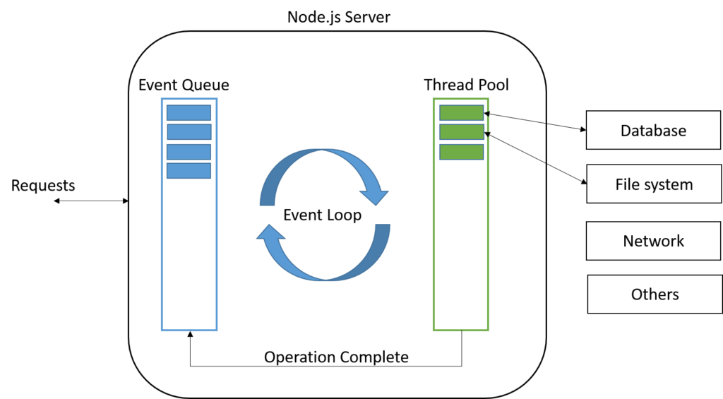

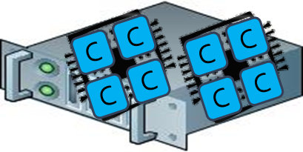
node.js
Single-threaded with large software library (MySQL, S3, …)
https://nodejs.org/api/documentation.html
Notes:
Look at File System in the documentation --- e.g. read functions return promises! Because FS could be on a separate machine…

Slide 5
node.js
Single-threaded with large software library (MySQL, S3, …)
https://nodejs.org/api/documentation.html
Notes:
Look at File System in the documentation --- e.g. read functions return promises! Because FS could be on a separate machine…

Slide 6
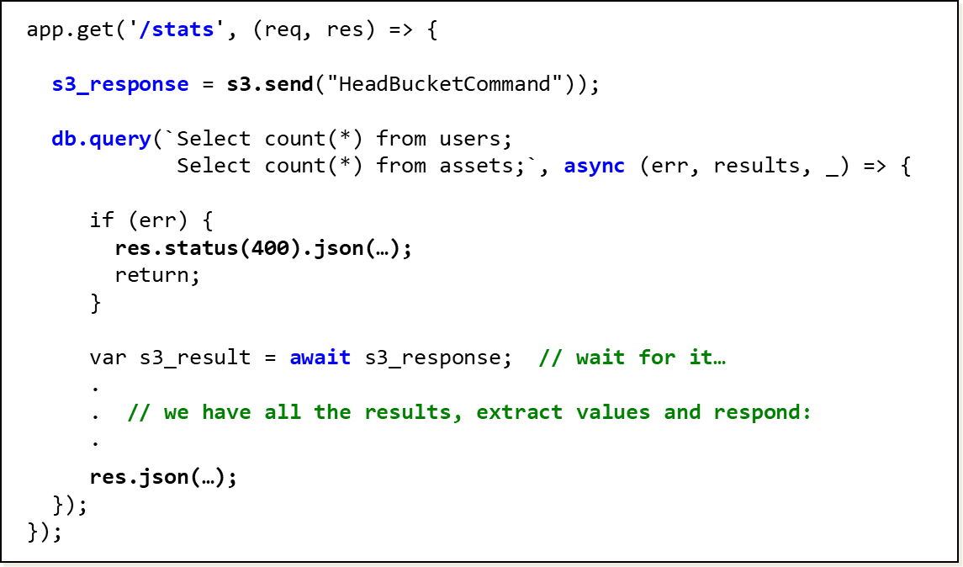
Example

Slide 7
Example

Slide 8

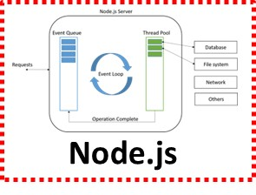
Vertical scaling of Node.js
Replicate node.js across the cores…
Node.js

Slide 9
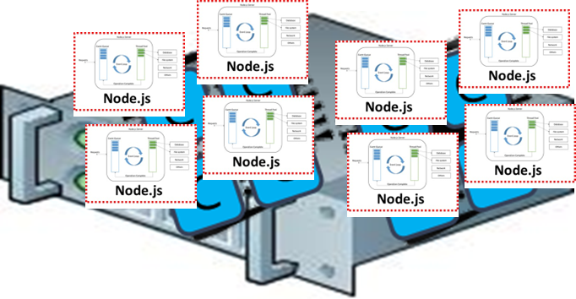
node.js cluster module
Cluster offers scale-up functionality (ref, ref)
PM2 is another good option (ref)
const cluster = require("cluster");
const totalCPUs = require("os").cpus().length;
var app;
if (cluster.isMaster) {
console.log(`Main process ${process.pid} has started`);
console.log(`Number of CPUs is ${totalCPUs}`);
// replicate across the cores:
for (let i = 0; i < totalCPUs; i++) {
cluster.fork();
}
}
else {
console.log(`Working process ${process.pid} started`);
app = express();
.
. // app.get() handlers
.
}

Slide 10
Vertical Scaling pros and cons
Easy to write your programs to run on a single machine.
Most languages support multi threads / processes
Most “off the shelf” software is written to run on one machine.
Eg.: MySQL, node.js, etc
Modern servers can do a lot of work in parallel with ~96 cores.
Cannot handle huge workloads (millions of requests)
Single point of failure.
Price/performance ratio is poor for top-of-the-line machines.
48 2-core machines are much cheaper than 1 96-core machine
Vertical scaling is not scalable! Horizontal scaling enables true scalability…

Slide 11
Horizontal scaling => load balancer
You need a machine to distribute the incoming requests…
Load balancer => makes a cluster of servers act like one BIG server
The load balancer provides the same interface as a single server --- e.g. acts like a web server operating on a single network address
Load-balanced cluster
HTTP request
Load Balancer
Workers
11

Slide 12

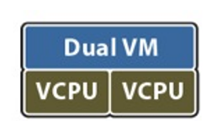
Virtual machines (VMs)
In the cloud we think in terms of virtual hardware
You don't rent a physical computer
You rent a "virtual" computer that can live / run anywhere

Slide 13
Virtual machines (VMs)
In the cloud we think in terms of virtual hardware
You don't rent a physical computer
You rent a "virtual" computer that can live / run anywhere

Slide 14
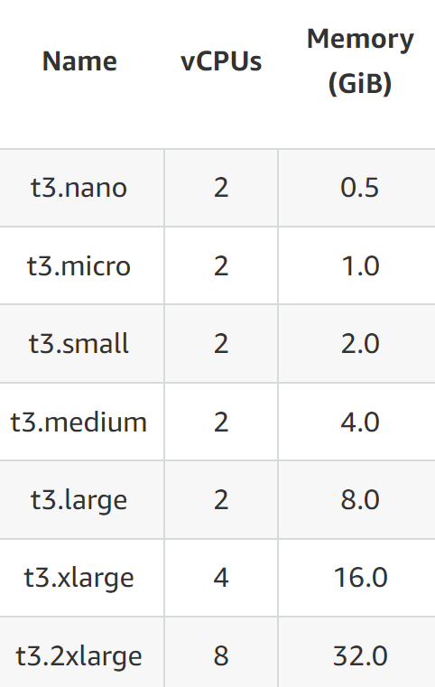
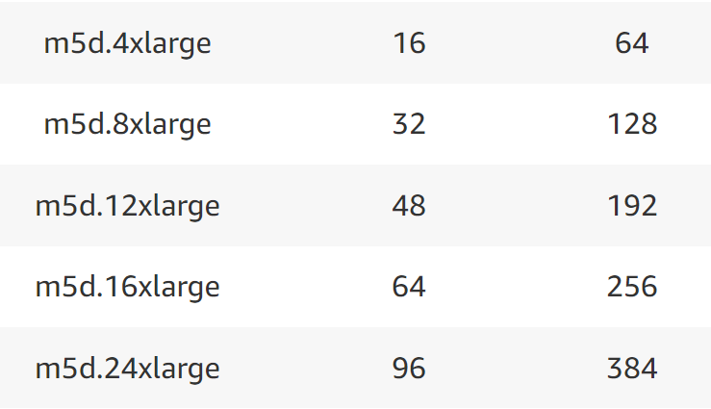
AWS EC2 instance types
AWS offers different VMs at different price points
t3.nano (2 cores, 0.5GB, remote SSD disk) $.0052/hour
m5d.24xlarge (96 cores, 384GB, local SSD disk) $5.424/hour

Slide 15
That's it, thank you!

Slide 16
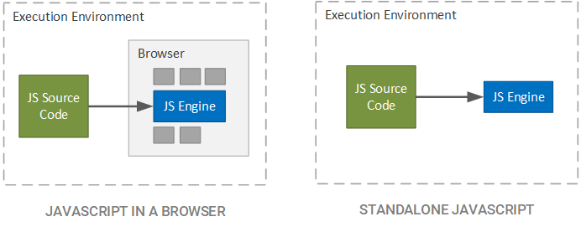
Node.js
JavaScript first appeared as client-side, scripting language
Node.js is runtime engine for executing JS outside browser
Node.js designed for server-side execution
Node.js

Slide 17
Node.js
Single-threaded with large software library (MySQL, S3, …)
https://nodejs.org/api/documentation.html
Notes:
Look at File System in the documentation --- e.g. read functions return promises! Because FS could be on a separate machine…

Slide 18
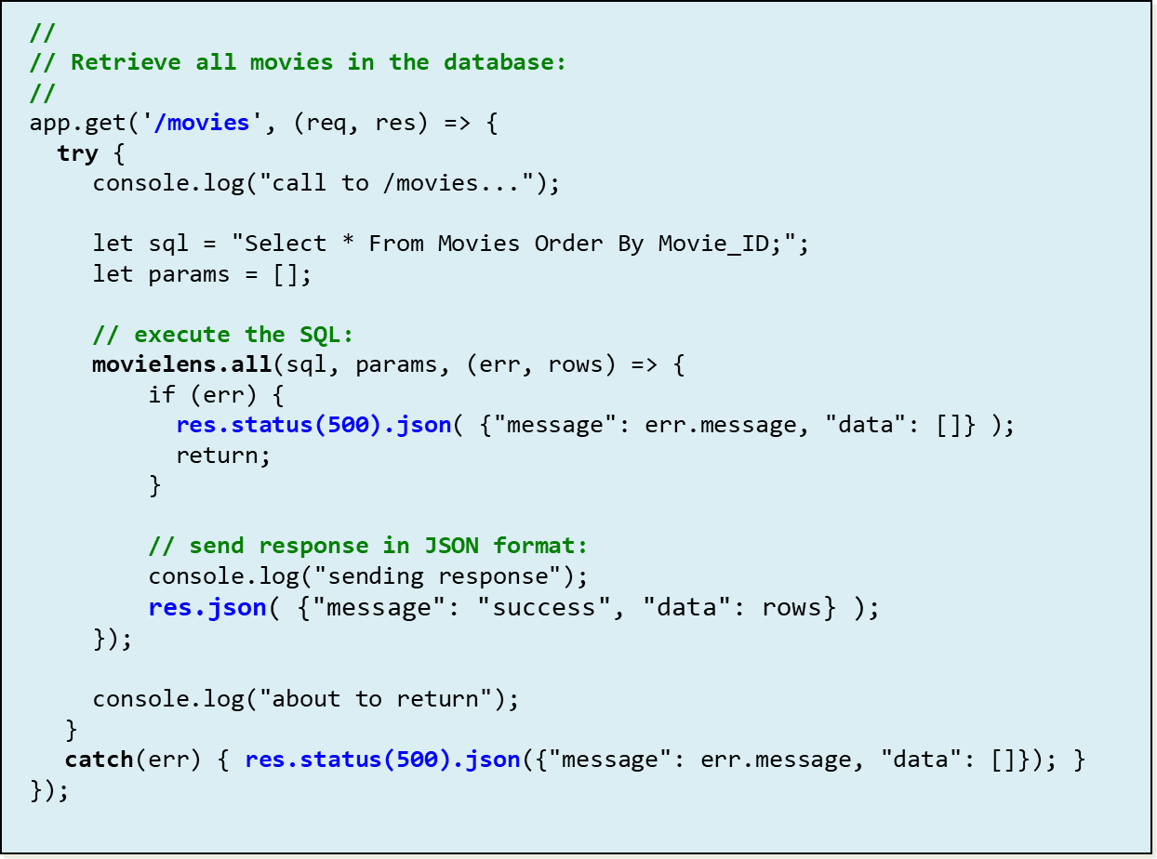
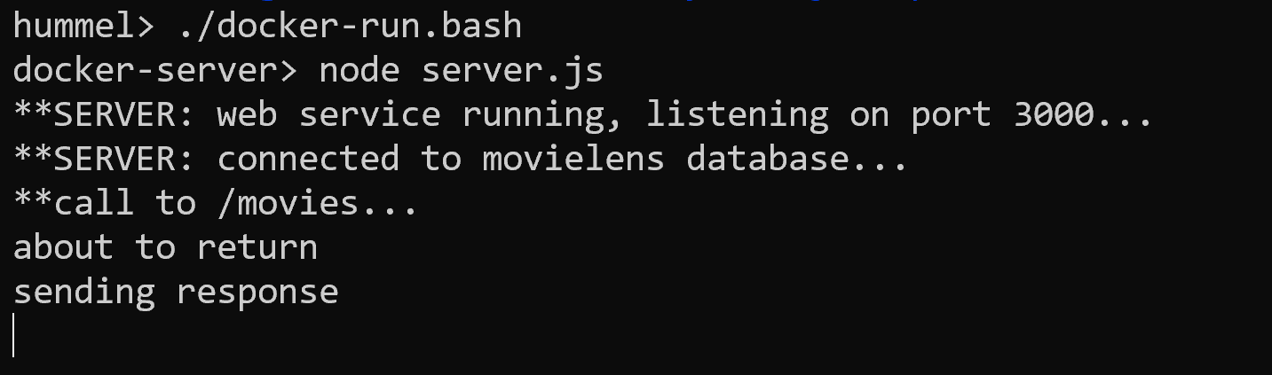
/movies running on Node.js

